Slide 1


Effects of hypoxia on gelatinous zooplankton predation of copepods in the Chesapeake Bay
Wen-Cheng Liu¹, Mary Beth Decker², James J. Pierson¹
1. Horn Point Laboratory, The University of Maryland Center for
Environmental Science, Cambridge, MD 21613, United States.
2. Department of Ecology and Evolutionary Biology, Yale University,
New Haven, CT 06511, United States.

Slide 2
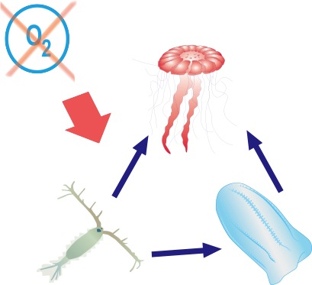
The scope of this study:
To understand how hypoxia affect the relationship between gelatinous zooplankton and other zooplankton?
Hypothesis :
Copepods are preyed upon more heavily by jellyfish under hypoxic conditions.

Slide 3
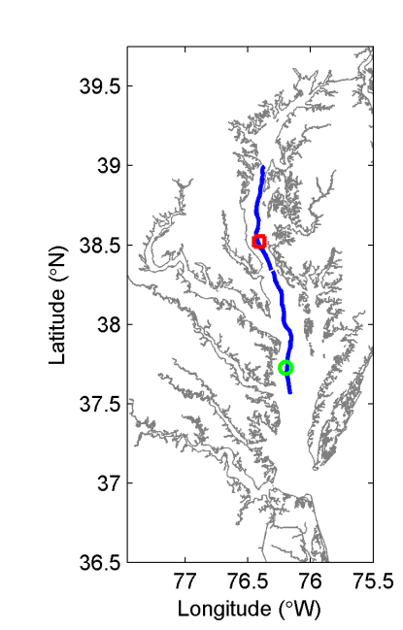
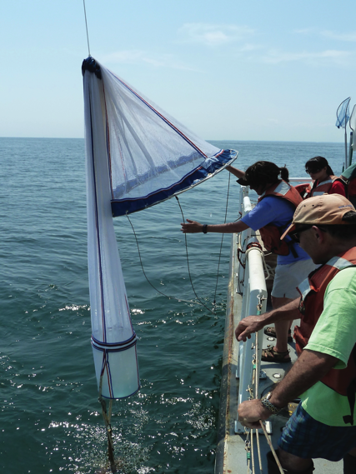
Method
Cruise:
2010: May August September
2011: May July September
Stations:
North (38° 31.32’ N, 076° 24.48’ W)
South (37° 43.68’ N, 076° 12.0’ W)
SCANFISH & CTD
Jellyfish abundance: Tucker Trawl
(Houde et al.)
Jellyfish gut content: Gel-net

Slide 4
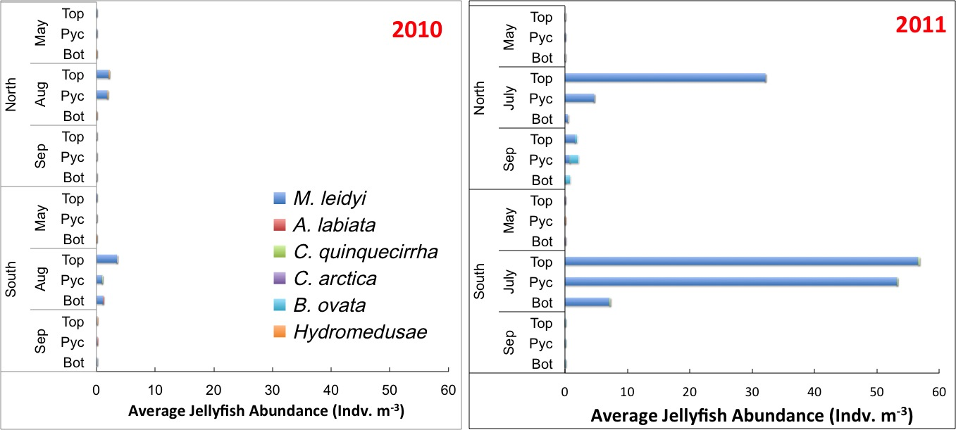
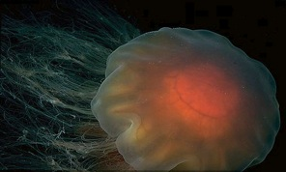
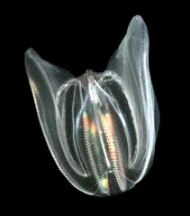
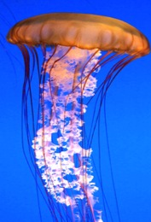
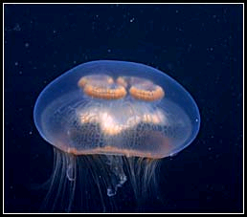
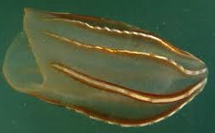
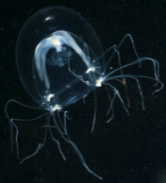
Gelatinous Zooplankton in the Bay
Dominant Species: M. leidyi
Nemopsis bachei
Beroe ovata
Aurelia labiata
Chrysaora quinquecirrha
Mnemiopsis leidyi
Cyanea capillata

Slide 5
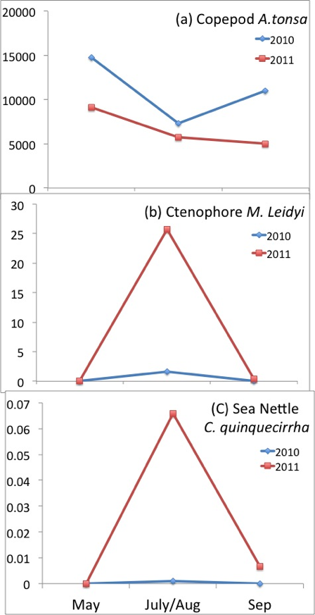
The relationship between gelatinous zooplankton and copepods
Inversely Correlated
More gelatinous zooplankton in hypoxic 2011, and correspondingly, less copepods.
Abundance (indv. M⁻³)
(Copepods data: Barba et al.)

Slide 6
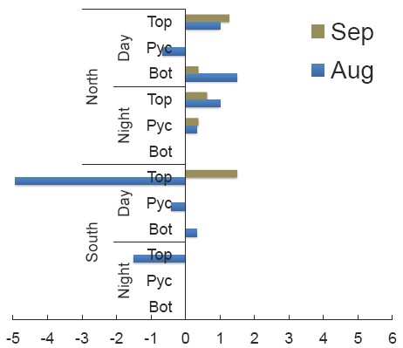
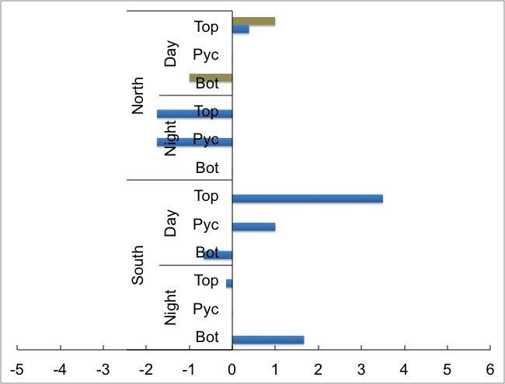
Gut contents analysis: average #copepod
Hypothesized
Preyed #Copepod
Results
DO
2010
2011
2010-N
Hypoxic
2011-N
Extremely hypoxic
2010-S
Normal
2010-N
Hypoxic
2010
Ctenophore
predation :
Hypoxia > Normoxia > Extreme Hypoxia

Slide 7
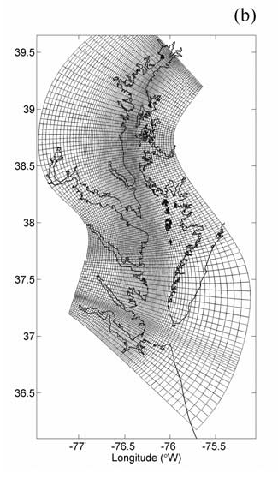
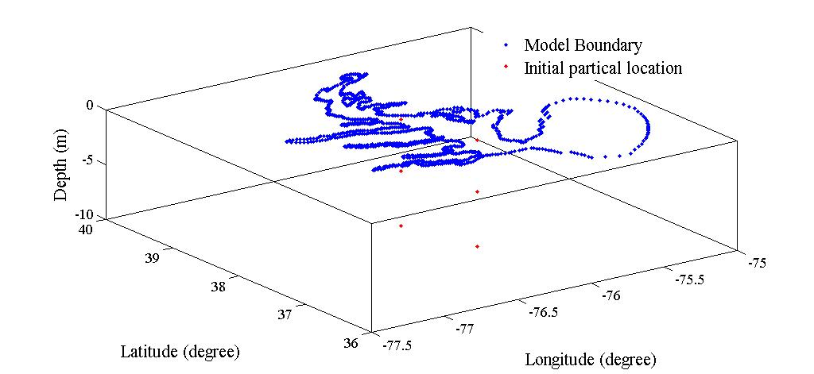
Alternative hypothesis….
Copepods are flushed out of the bay
Methods
(Li, Zhong, & Boicourt, 2005)
Lagrangian TRANSport (LTRANS) V₂
(North et al., 2008)
Chesapeake Bay Regional Ocean Modeling System (ROMS)
(Li, Zhong, & Boicourt, 2005)
Model set up:
          ● Initial location :
          North & South
          ● 5 releasing in 1997&1998
          (1st, 8th, 15th, 22th and 29th July,
          Duration = 31 days)
          ● Behavior :
          +DVM, -DVM, Passive
18000 particles
N
S
Depth =
0.25, 5, 10m

Slide 8
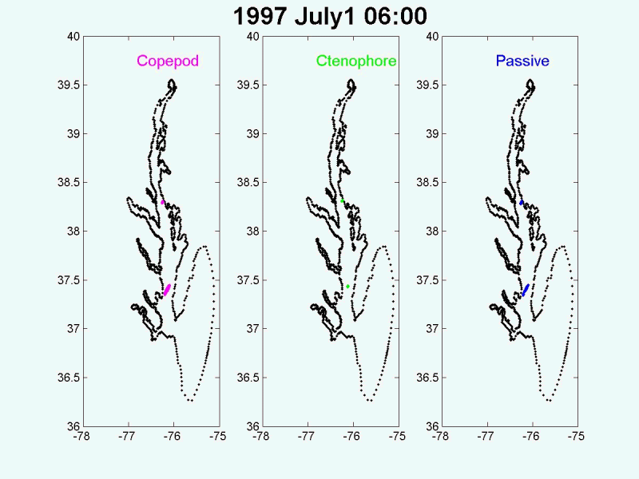
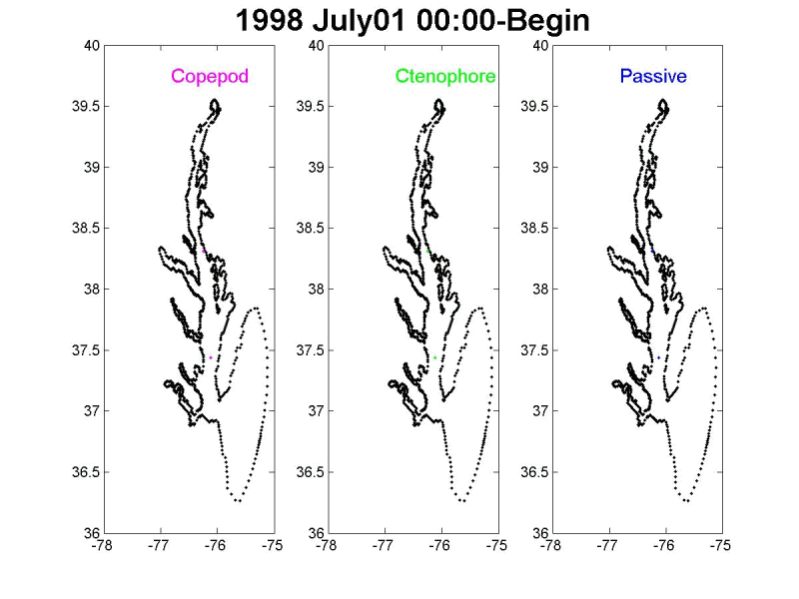
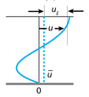
Preliminary Results
Passive particles were more spread out.
A gap between N & S (two way circulation)
Ctenophores were concentrated in the right bank.
(Longer daytime+ Coriolis Force)
Notes:
Hypothesis is asccepted.

Slide 9
Future study
Statistic Analysis: Factor Analysis
Feeding Experiment: impacts on microzooplankton
Model simulation:
  2010 & 2011 ROMS with DO
  Initial location: randomly distribution
  Modified behavior code:
Copepod
+DVM
Hypoxia avoidance
Ctenophore
- DVM
Hypoxia avoidance
Changing density with surrounding environment
other
A.tonsa eggs
(sinking)
Passive (Control)
.
.
.

Slide 10
~The End~
Thank you for your listening

Slide 11
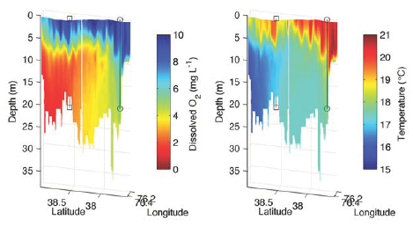
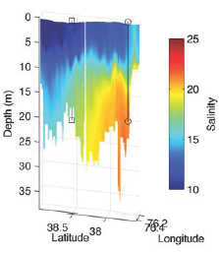
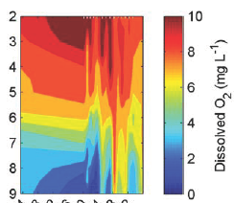
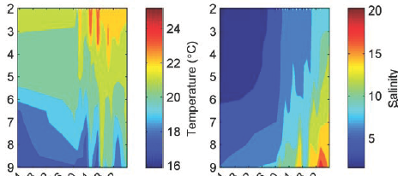
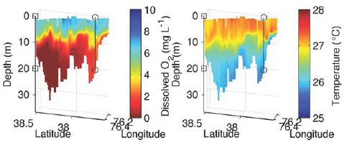
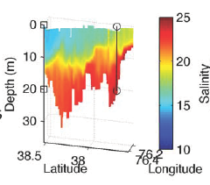
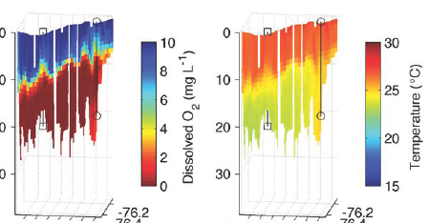
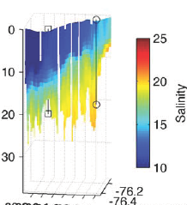
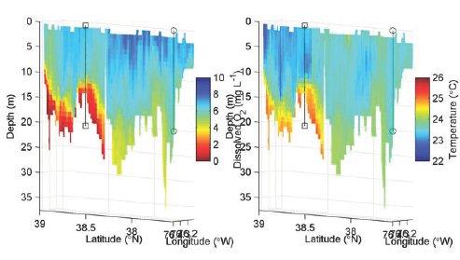
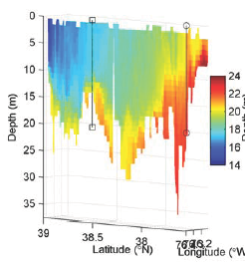
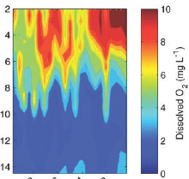
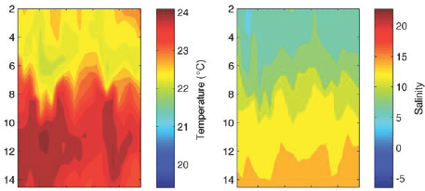
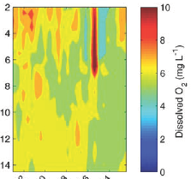
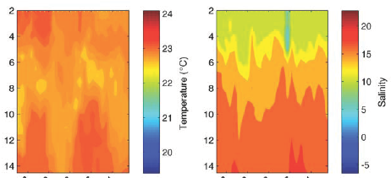
Hydrology
More hypoxic, warmer and lower salinity in 2011
Hypoxia
(DO < 2 mg L⁻¹)
Temperature
(T > 24 C)
Salinity
(PSU < 10)
2010
2011
DO Temp. S
DO Temp. S
MAY
Aug10/ Jul 11
Sep
N
S
Notes:
Hypoxia: In the early summer, the bay was more hypoxic in 2010 than in 2011.
But in the middle summer, the bay was more hypoxic in 2011: it was almost anoxia below the pycnocline for both north and south station. There hypoxic conditions were similar between 2010 & 2011, hypoxic in the bottom water of North station and normoxic in the south station.
Temperature: It is warmer in 2011, it was around 2C higher in May2011 and was still warm in the September. I believe every one here still remember the winter in last year was not cold at all.
Salinity: the salinity was much more lower in 2011, the salinity was always lower than 10 in the surface through the summer.
In conclusion, it is warmer, lower salinity and more hypoxic in the 2011 than in 2010.

Slide 12
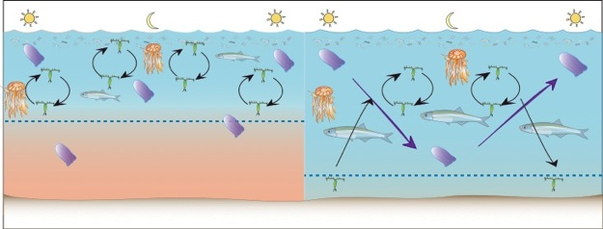
Introduction
Low copepod biomass correlated with hypoxia
(Roman et al 2005)
Why?
Directly
Indirectly
Habitat squeeze
Less jump frequency
Higher mortality
Lower egg hatching rate
A. tonsa
(Roman et al 2003)
(modified from Pierson)
Ctenophore Clearance rate
Nauplii Hatched (%)
(Decker et al., 2004)

